Slide 1
Attendance using Face Recognition System
Computer Vision
Group 14
AU2040260 - Pratham Lalwani
AU2040167 - Daksh Suthar

Slide 2
Introduction and Problem Statement
Attendance management is essential for any organization.
The haar-cascade and LBPH algorithms for face detection and recognition, a system that can automatically detect and recognize faces in real time.
Existing attendance management systems are inefficient and prone to errors.
This project aims to create an efficient, accurate, automated attendance management system using face recognition technology.

Slide 3
Existing Body of Work
Existing systems uses techniques such as biometric systems, barcode scanners, and face recognition to track attendance.
These systems have some limitations, such as cost, complexity, or low accuracy.
The attendance of large groups of people is not easy to keep track of with the manual system.

Slide 4
Literature Review
Face recognition technology attendance systems use algorithms such as Local Binary Pattern Histogram and Haar Cascade to analyze unique facial features and match them with a database of known faces.
These systems offer benefits such as accuracy, convenience, hygienic operation, and easy tracking of attendance records.

Slide 5
Approach:
The attendance management system approach will use facial technology to identify and track attendees.
The system will be developed using Python programming language and OpenCV library. The system will use haar-cascade and LBPH algorithms for face detection and recognition. The system will automatically detect and recognize faces in real time.
The system will be integrated with a database or CSV file to store attendance data. Reports for analyzing attendance data will also be provided by the system.

Slide 6
Discussion
Applying Haar Cascade for face detection.
Applying LBPH for face recognition.
Euclidean distance.

Slide 7
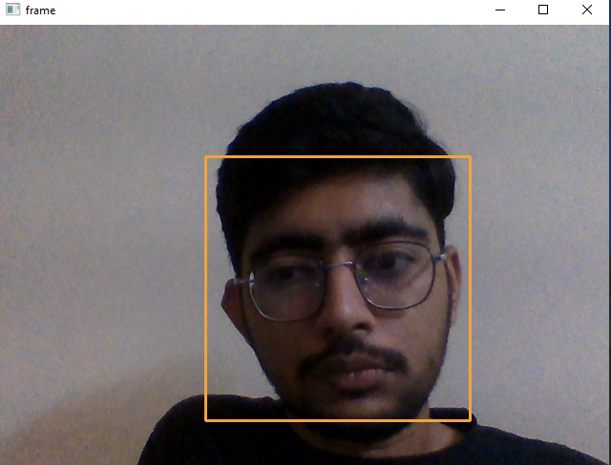
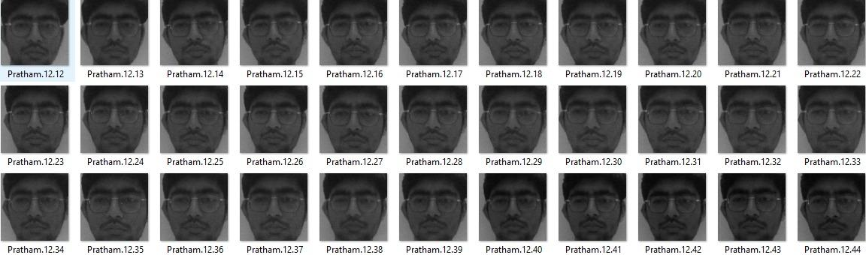
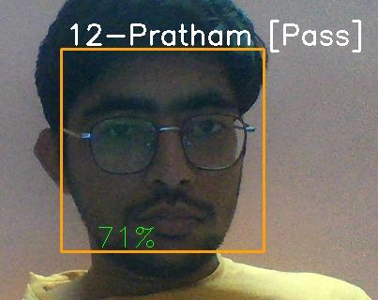
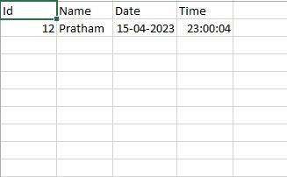
Results
Face detection with Haar Cascade
Dataset training for LBPH
Face Recognition with LBPH
CSV file generation

Slide 8
Role of each Group Member
Pratham Lalwani
Implementation of Haar Cascade
Implementation of LBPH
Daksh Suthar
Learning LBPH
Implementation of LBPH

Slide 9
References:
Jaiswal, A. (2022, October 19). Face Detection using Haar-Cascade using Python Uncategorized. Analytics Vidhya. https://www.analyticsvidhya.com/blog/2022/10/face-detection-using-haar-cascade-using-python/#:~:text=Haar%20Cascade%20is%20a%20feature
Mittal, A. (2020, December 21). Haar Cascades, Explained. Medium. https://medium.com/analytics-vidhya/haar-cascades-explained-38210e57970d
Harmouch, M. (2021, May 28). Local Binary Pattern Algorithm: The Math Behind It️. The Startup. https://medium.com/swlh/local-binary-pattern-algorithm-the-math-behind-it-%EF%B8%8F-edf7b0e1c8b3
Understanding Face Recognition using LBPH algorithm. (2021, July 12).AnalyticsVidhya. https://www.analyticsvidhya.com/blog/2021/07/understanding-face-recognition-using-lbph-algorithm/

Slide 10
Thank You!

